Slide 1
25kW is the New 15kW
The Need to Update Vermont’s Residential Net Metered
Solar Application & Registration Process
to Meet Customers Electrification Needs

Slide 2
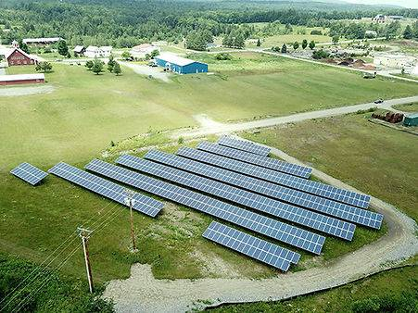
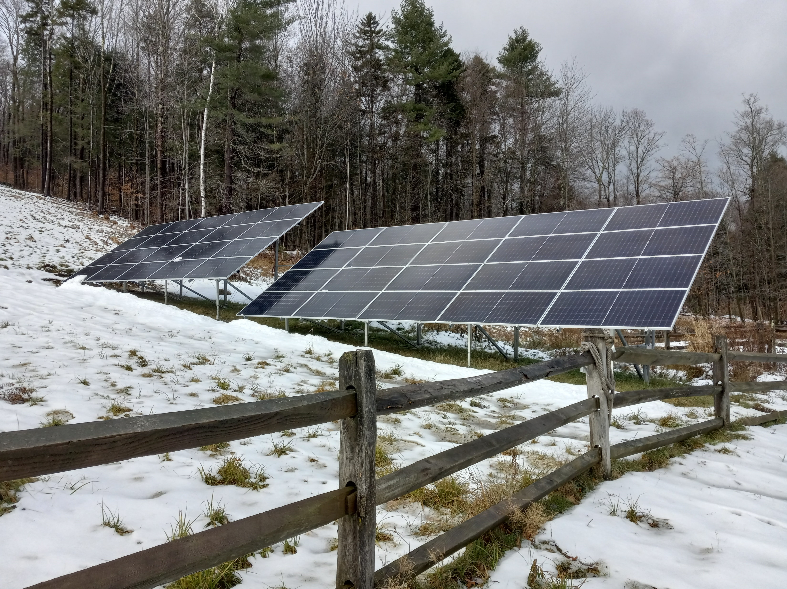
In 2014, Act 99 established that ground mount arrays <15kW AC use a quick registration process while ground mount arrays
15-150kW AC must go through a lengthier application process
150kW AC solar array outside Lamoille Union HS
15kW AC residential solar array with 435W panels (66’x12’)

Slide 3
Modern Solar Panels Can Produce 28% More Solar Power Using Almost the Same Amount of Land!
108’ 6”
12’ 11”
CS 320W Module
6.4’x3.2’
Layout of a pre-2017 15kW array using 66 320w panels covering roughly 1400 ft²
109’ 10”
13’ 11”
QCell 485W Module
7.2’x3.4’
Layout of a modern 25kW array using 60 485w panels covering roughly 1500 ft²
Building a 25kW instead of a 15kW array produces enough extra electricity
every year to power a Ford Lightning for over 25,000 miles!

Slide 4
The Efficiency of Solar Panels Has Advanced Making the 15kW Application Limit Outdated
Average residential solar panel size in 2014: 250W
Average residential solar panel size in 2024: 435-500W
New solar panels produce almost double what a solar panel produced when Act 99 was written in 2014!
Now, a homeowner can produce much more power from a solar array in 2024 than one with a similar footprint in 2014
If the 2014 15kW application limit was scaled to the size of modern solar panels, a 25kW application limit would be realistic
Current law allows rooftop arrays up to 500kW to use the faster application process!

Slide 5
Application Process Registration Process
15kW-150kW
45 day advance notice to abutters and mandatory ANR review for wetlands
Mandatory PUC 30-day review after the 45 day advance notice period even if there are no objections to the application
Utility interconnection approval is required before a CPG application can be submitted
Utility must issue interconnection approval letter to the applicant stating any additional requirements for interconnection by the 31st day following the completed interconnection application
Can be further delays in application process of unknown duration- No mandated timeline for the PUC to issue a CPG
Minimum time to complete application process: 4 months
$5,000-$20,000 to hire consultants to complete application process
<15kW
No advance notice or ANR review required
A utility has 15 days from the day an application is filed to raise interconnection concerns with the PUC. Once a concern is raised, the 15 day clock is stopped until resolved
CPG and interconnection approval happen simultaneously
Almost never additional delays beyond the 15 days
Rarely >30 days to complete registration process
No additional costs associated with registration process

Slide 6
Sample Annual Electrical Consumption in a Modern Electrified Home
Typical annual domestic load in Vermont is about 6,000 kWh a year
EV Charger for commuting 30 minutes
o/w to work 3,000 kWh/yr
Heat Pump Water Heater 1,300 kWh/yr
Heat Pump (1 room) 3,000 kWh/yr
Heat Pump (1800 ft² well insulated home) 8,000 kWh/yr
Heat Pump (>3000 ft² home) 15,000–20,000 kWh/yr
An average residential solar system today is about 10 kW AC. With a couple of heat pumps and even one EV, this easily increases usage to 25 kW AC.

Slide 7
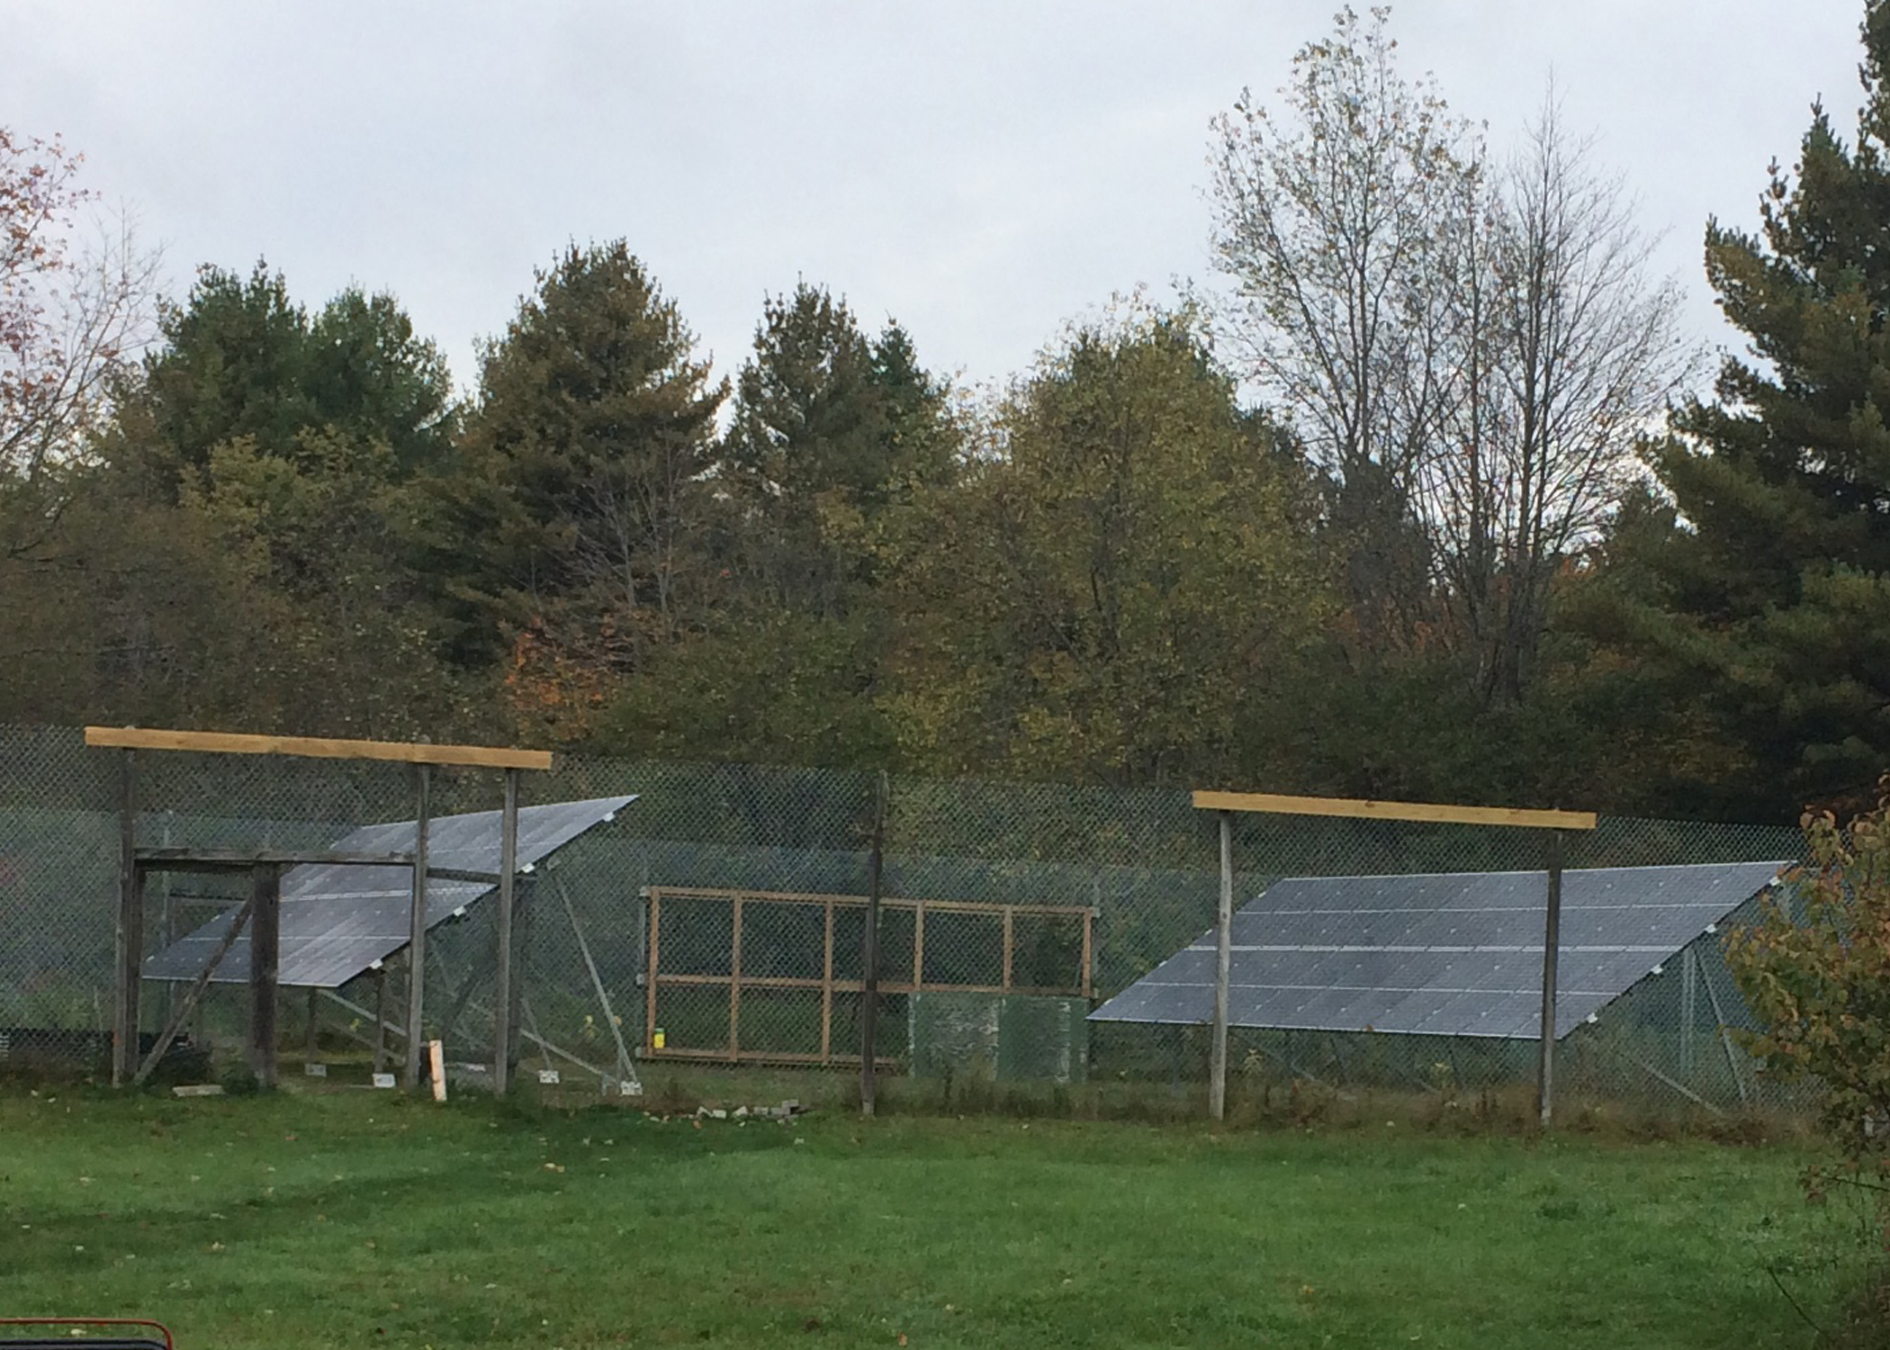
The Potential Cost of This Change is Minimal
Even if all 82 homeowners who put up a 15kW array in 2023 had instead put up a 25kW, the cost shift, even using the Public Service Department's highly flawed methodology, would only be 12 cents/yr to the average Vermont household
17kW Array in Southern Vermont

Slide 8
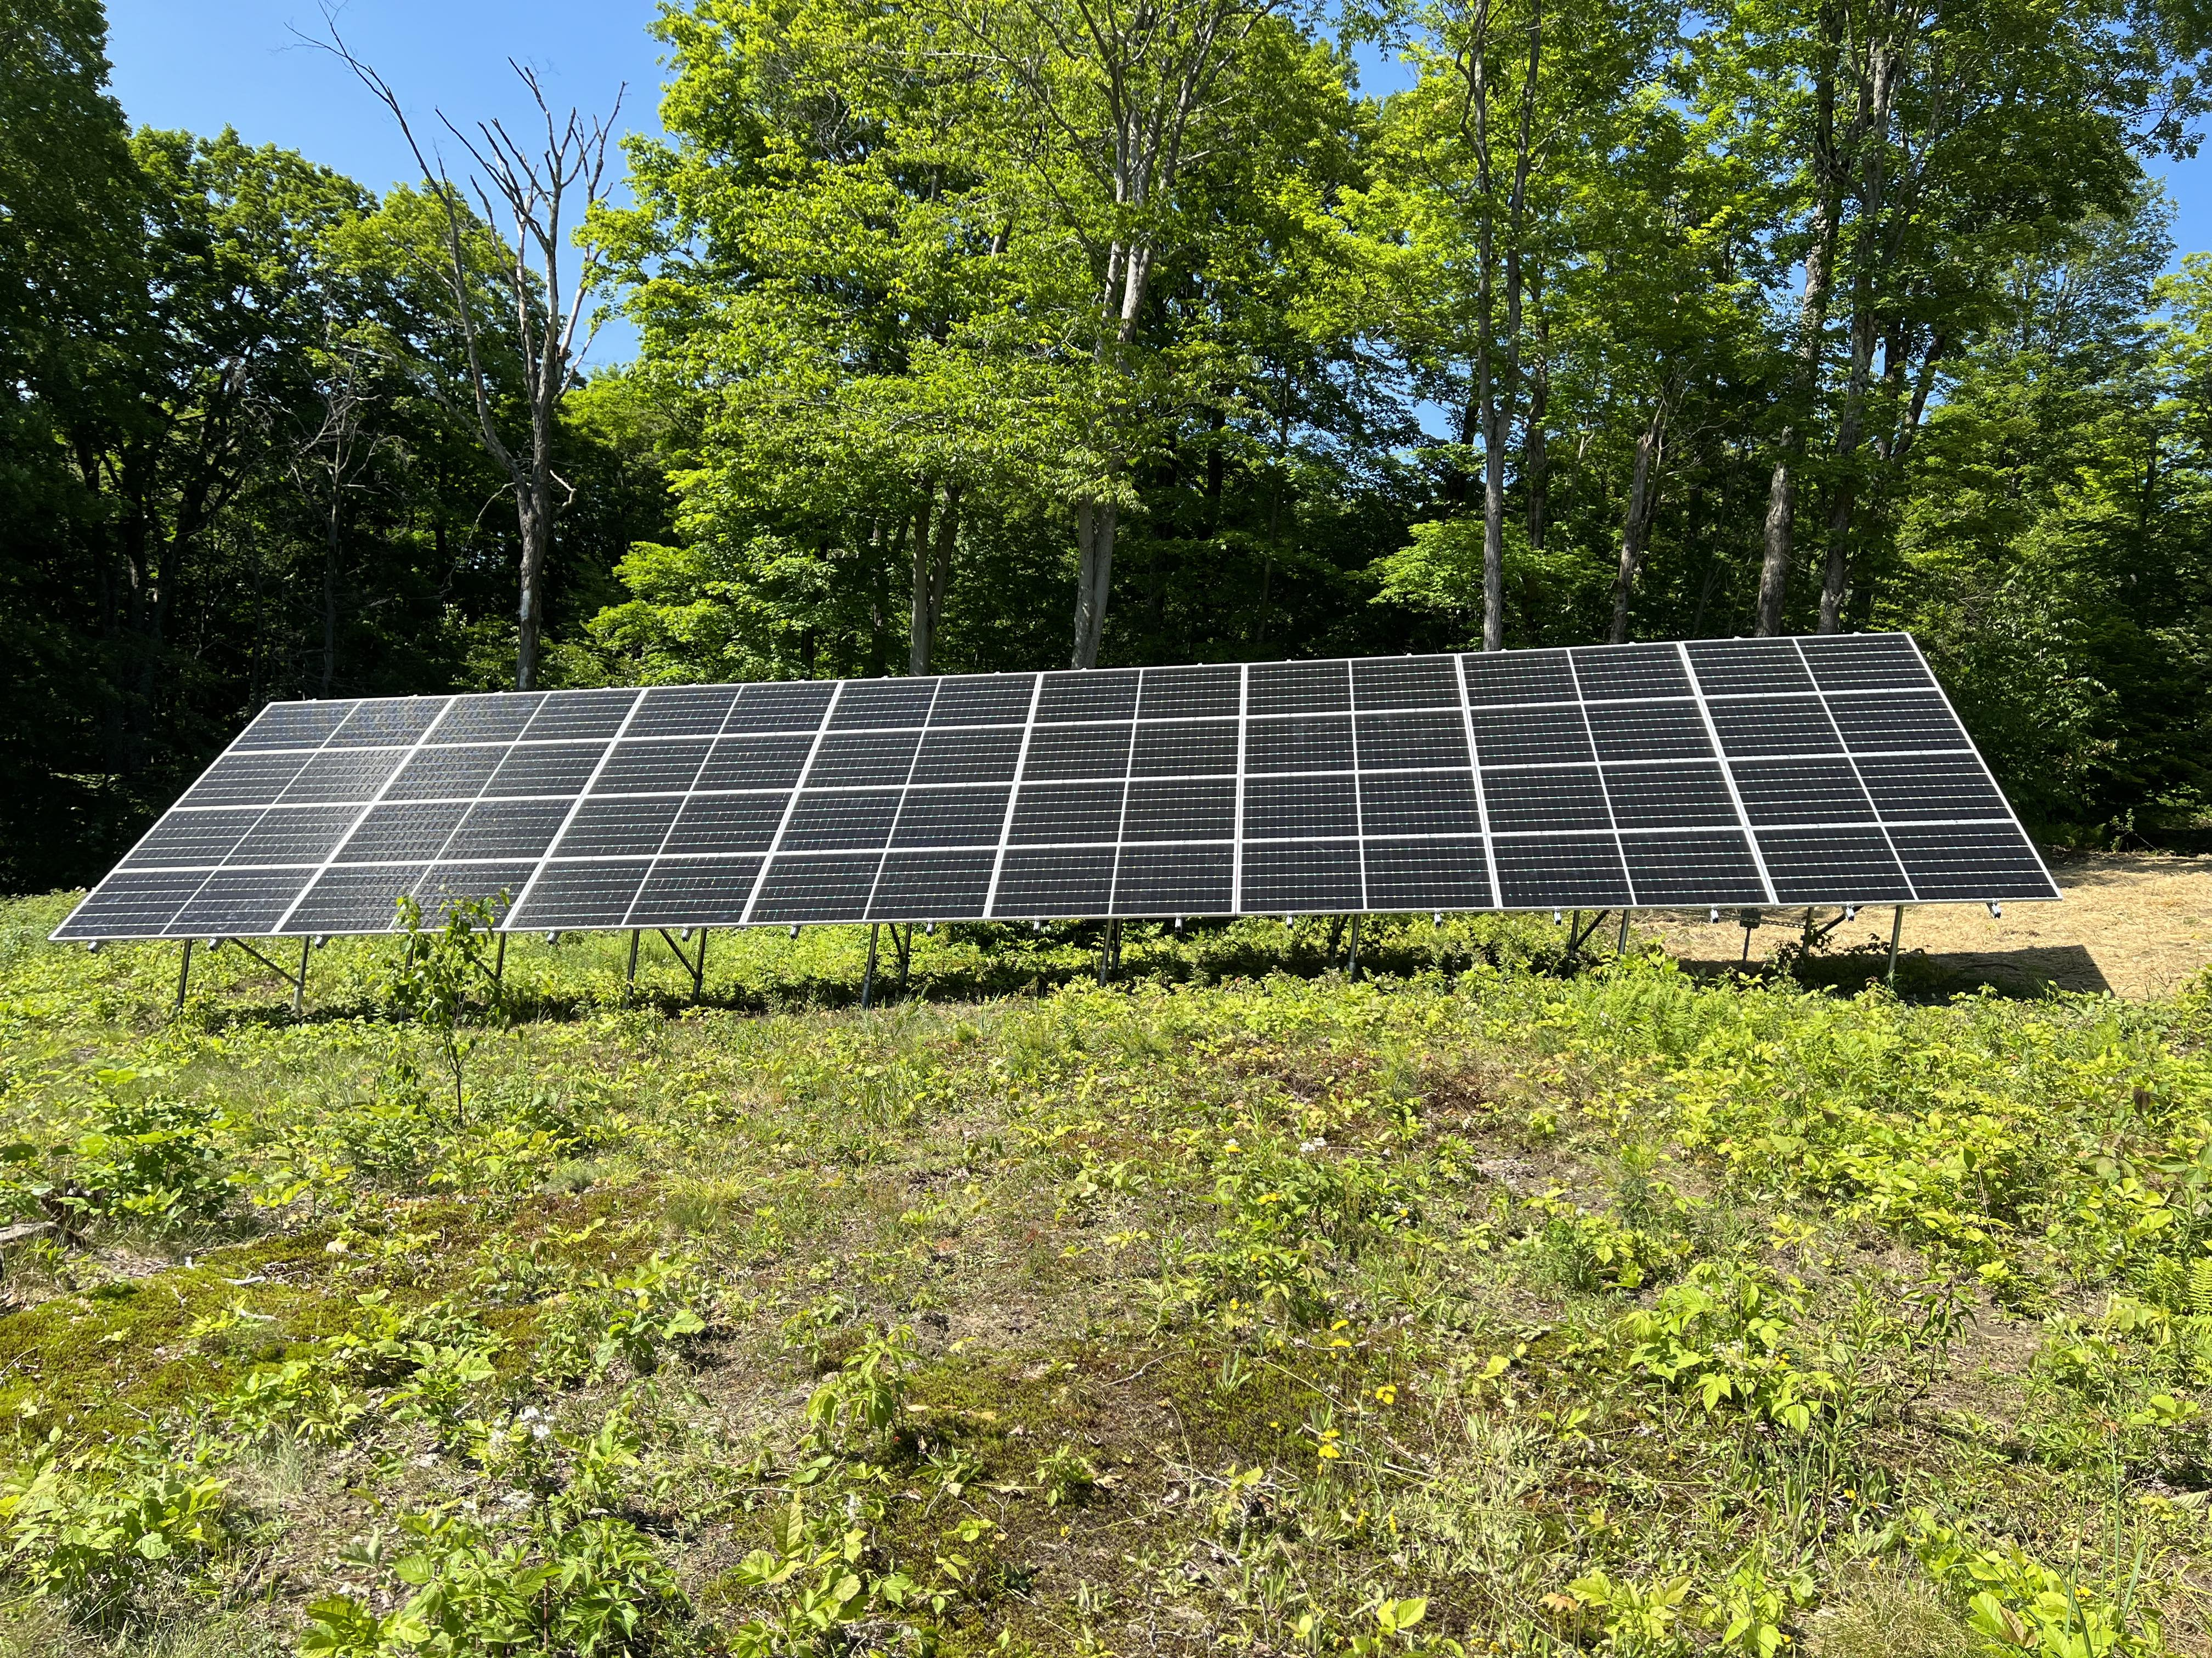
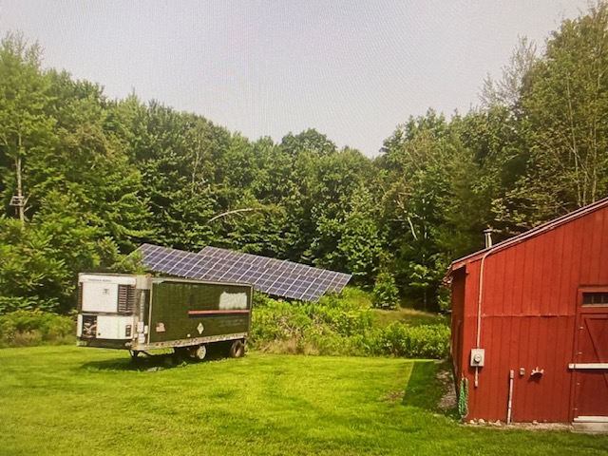
Two Similar Sized Arrays, Two Very Different Results: Larger Backyard Projects Not Built!
15kW residential solar array in Barnard
25kW residential solar array
Registration Process: CPG granted by the 15th calendar
day after submission almost all the time
Application Process: Four months minimum for a CPG
Only 11 CPG applications have even been filed since 2020 for 15-25kW AC projects
The uncertainty, cost and length of time needed to complete the 15kW-150kW registration process is restricting the size of backyard solar projects!

Slide 9
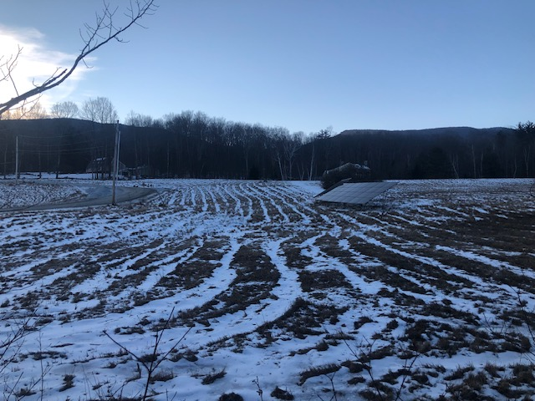
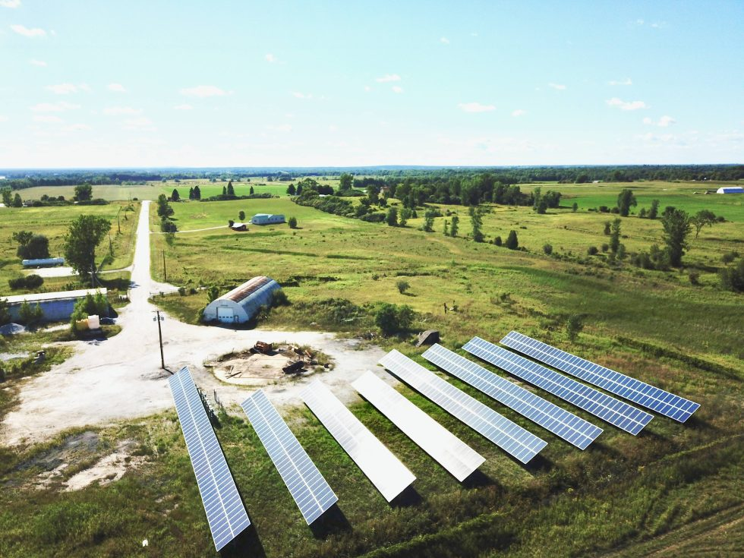
These two very different sized projects do not need the same application process
22.5kW AC residential solar array
150kW solar array in Alburgh

