Slide 1
The Permitting Process for Required Electric Grid Distribution Upgrades is Broken and Needs Fixing
In recent years, the permitting for many solar arrays has been singled out
for a more time consuming and unpredictable process
than all other forms of development

Slide 2


New Developments Require Changes to the Electric Grid Including Line Extensions and Upgrades
Line extensions consisting of new wires and poles are required to connect to existing power lines.
Upgrades to existing lines include switching to heavier gauge wire, adding/moving power poles, and upgrading transformers.
Heavier wire and additional poles in the existing right-of-way
New poles and wires
Notes:
Single slide: with examples – Most frequently adding or moving poles to accommodate develop,emt

Slide 3
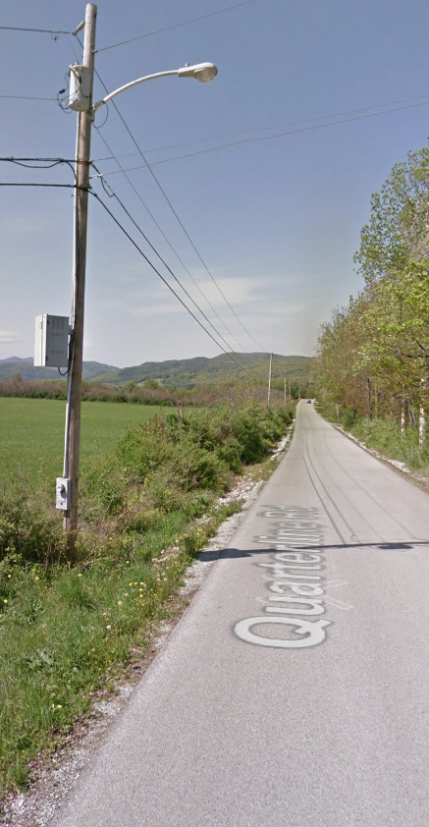
Electric Grid Infrastructure Requiring Distribution Upgrades Are Usually Not in Pristine Locations
Existing distribution infrastructure is:
  generally located along roadsides
  regularly undergoes “vegetative maintenance”(clearing, mowing, application of herbicides)
  often located on private property and subject to the mowing, landscaping and farming decisions of the landowner
Since 2020, VT utilities have moved/installed over 6,500 poles
Utilities routinely obtain the necessary permits and/or follow Best Management Practices for these distribution upgrades
Maintenance in the wake of storms, including replacing poles, is routinely conducted without advanced permitting
REV is unaware of any significant environmental issues caused by the utilities’ management of these distribution upgrades.

Slide 4
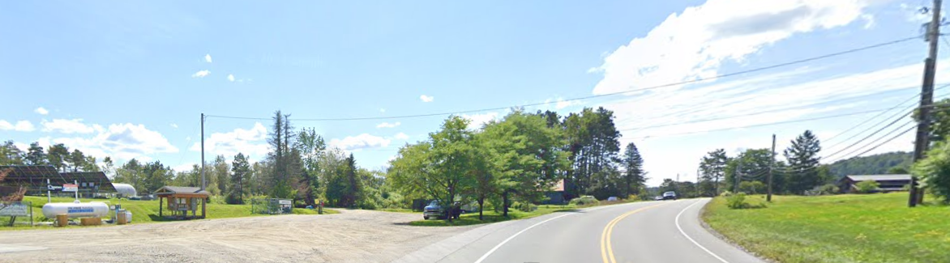
Solar Array Connecting to the Electric Grid
Requiring a Distribution Upgrade
New pole in the existing right-of-way
Solar Array

Slide 5
Increasingly, Distribution Upgrades for Solar Projects are Facing Stricter Standards Than All Other Forms of Development
For most distribution upgrades, utilities follow Best Management Practices and/or obtain all necessary permits
For some solar projects, ANR is now requiring the builder, rather than the utility, to conduct environmental assessments and permitting for these upgrades before a CPG is granted
This provides no environmental benefit but makes it much more challenging to build renewable projects
Based on information from ANR, this first occurred on one project in 2006 and not again until 2017 but is now happening with increasing frequency though there have been no changes in Rules or statutes to mandate this change
REV is unaware of this ever being required of any Act 250 project!

Slide 6
Why is This a Problem?
ANR’s new requirements introduces three major problems to the Section 248 CPG process
Lack of Legal Access to the Land that Must Be Assessed
  Project developers do not own, lease, or have a right to access the land under existing distribution infrastructure. If the landowner for this property refuses access to it, conducting an environmental assessment becomes impossible.
Sequencing
  Because ANR’s new procedure requires the environmental assessment to be conducted prior to the completion of permitting, it increases the burden on utility staff time and the risk for developers since time-consuming distribution upgrade studies must be completed for projects that may never be successfully permitted
Legal Jeopardy
  This new procedure places conditions on the developer’s permit for work done by the utility and thus creates a legal obligation for the developer for actions that they cannot control
Notes:
Get rid of background image

Slide 7
Allowing Solar Projects to Use the Same Process As All Other Distribution Upgrades and Development Won’t Harm Vermont’s Natural Resources!
Legislation that makes it explicit that the environmental review for distribution upgrades for Section 248 projects should be the same as for other types of distribution upgrades is needed to:
Ensure renewable energy development will face the same scrutiny as other forms of development rather than experiencing added hurdles
Allow utilities to do the well-managed permitting work they already do on the vast majority of distribution upgrades on all solar projects
3. Return to historical practices that have protected Vermont’s natural resources
  While ANR cites a 2006 case as the precedent for these requirements, it has not been, and is not now, standard procedure for Section 248 projects
This clarification leaves the financial responsibility of developers unchanged
  Developers remain responsible for the full cost of the distribution upgrades performed by the utilities including all planning, study, materials, and labor costs

